Slide 1
LTU HelpDesk
Together We Achieve

Slide 2
Features
User Accounts
Achievements
Medals
Profile
Help Requests
eLearning Programme
Training Requests
Course Audit
Skills Audit

Slide 3
User Accounts
Users have accounts which allows us, to track their ILT progress.
Users are assessed on a Bronze, Silver and Gold system.
Users are required to have a number of points before progressing onto the next level.
On registration a user is awarded an Achievement worth 50 points which makes them a Bronze Medal user.
Currently this is only open to Staff.

Slide 4
Achievements
Achievements are awards that are given for completing certain tasks.
They can be used to top-up point levels for the User Medal System.
Achievements are rated in three bands:
Band 1 achievements are worth 50 points
Band 2 achievements are worth 75 points
Band 3 achievements are worth 100 points

Slide 5
Medals - Users
Medals are awarded to users to visually rate that user.
It adds an element of competition to the HelpDesk between the users and promotes use of Training and Moodle good practice.
Users are awarded medals based on a mathematical formula^{(See next page)}.
This gives Users a more direct feedback on how they are performing on Moodle, and IL training in comparison to others in the college.

Slide 6

Medals – Users (Cont.)
Training
Basic Skill (BS) – 50 points
Intermediate Skill (IS) – 100 points
Advanced Skill (AS) – 150 Points
Course Audit
Basic Award = 250 points
Intermediate Award = 500 points
Advanced Award = 750 points
S = Score | C = Courses | SP = Skills Points | AP = Achievement Points
Gold: $\left(\left(S≥∃\left(C∋x=750\right)+y\left(C−C_{x }\right)≥\left(500 × y\right)\right)+\left(\begin{aligned}SP ≅\left(\left(100 ×IS\right)+(3 ×150)\right) \\ +AP\end{aligned}\right)\right)$
Silver: $\left(\left(S≥\left(500 ×\left(C÷2\right)\right)\right)+\left(\begin{aligned}SP≅\left(\left(50×BS\right)+300\right) \\ +AP\end{aligned}\right)\right)$
Bronze: $S$ $=$ $50$

Slide 7
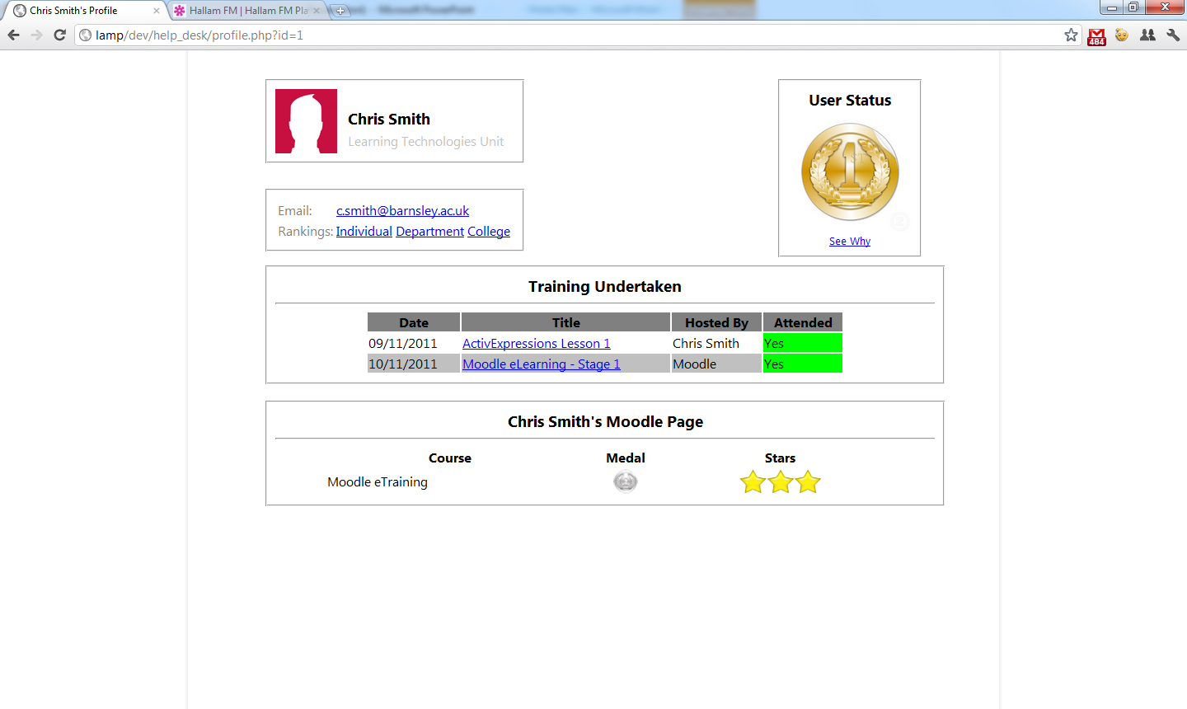
Profile
Users have access to User Profiles.
These have three views, depend on who views the profile.
A User can see elements of their profile that other users can’t.
Other users can see limited information about that user.
Administrators can see a mixture of the two views.

Slide 8
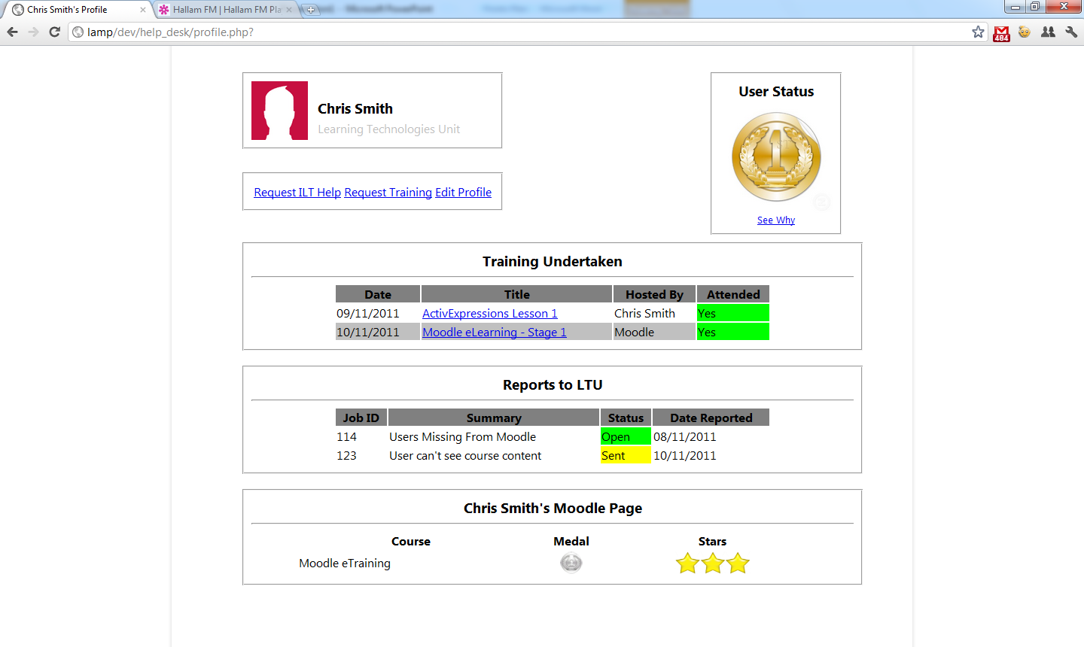
Help Requests
Though this resource, Staff can send Help Requests straight to the relevant support officer.
Each Department is registered to a Support Officer who receives these requests straight to their account.
Users can also track requests, see past requests and update current request information as well as “reactivate” closed requests.
This is one of the features that only that user and an administrator can see on their Profile Page.

Slide 9
eLearning - Screencasts
This System will link into the Moodle eLearning on Moodle.
Users will be given a code at the end of each video/unit to enter into the HelpDesk.
eLearning has a number of Achievements and points attached to it.
eLearning falls under Training on the Staff Profiles.

Slide 10
Training Requests
Staff can book Training sessions through the HelpDesk.
This will allow for us to more accurately track the training the staff have had and target specific groups for different levels of training.
Support Officers must register and attendance on the system or produce a self-register code for the staff members to use.
This feature is visible on the profile for all to see.
Training Sessions have Achievements and Points attached to them.

Slide 11
Course Audit
Course audits can be carried out on the HelpDesk too!!
Provides Admins with an easy to use form to fill in.
Automatically produces a graphical report for Users to see and for administrators to print out for addition to department reports.
Allows easy access to historical data.
Anyone connected to a course can see that courses audit page.
Only Administrators and users connected to a course can see the results on a Profile page.
The Course is given a medal of its own and the points from the stars received contributes towards the users connected to the course.

Slide 12
Skills Audit
Skills Audits can also be carried out on HelpDesk.
These audits can be linked or anonymous to users but are always linked to departments.
Skills Audits have Achievements attached to them.
Admins can question the results of linked audits if they feel they have been falsified.
When an audit is released, users are prompted to complete it when they log in.
Audits are done in stages, so to take away the effect of it looking lengthy.

Slide 13
System Functions
Historical Data is easy to access.
User Administration Features.
Plugin's possible for other LTU produced/managed resources.

